Slide 1
10 Ways to Help Your Child Learn Maths
Seán Delaney
Marino Institute of Education

Slide 2
1. Promote a Positive Attitude to Maths
I was never any good at maths myself
You’re doing honours maths? You must be a genius!
Sure when do you ever use algebra in real life?
Some people are just good at maths and others are not

Slide 3
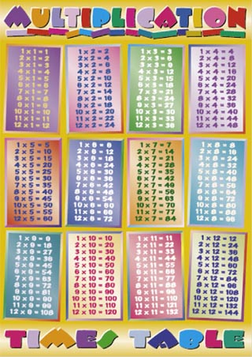
2. Look at Tables Differently

Slide 4
Learn Related Facts Together:
6 + 7 = 13
7 + 6 = 13
13 – 7 = 6
13 – 6 = 7

Slide 5
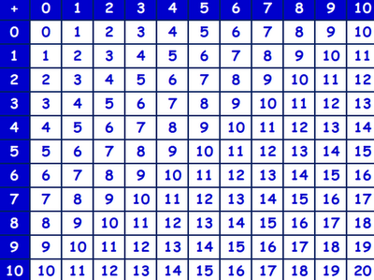
Addition Table

Slide 6
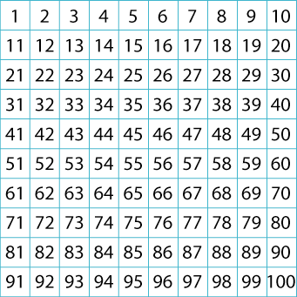
Hundred Square

Slide 7
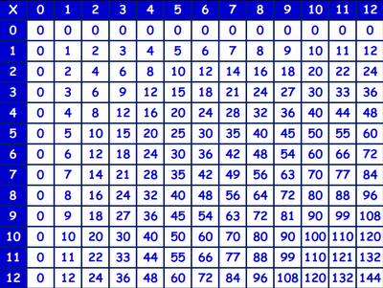
Multiplication Table

Slide 8
3. Ask Your Child to Teach You Maths
5 – 1
72 – 48
1 ½ + 3 ¼
148 ÷ 7
Find 10 % of 76

Slide 9
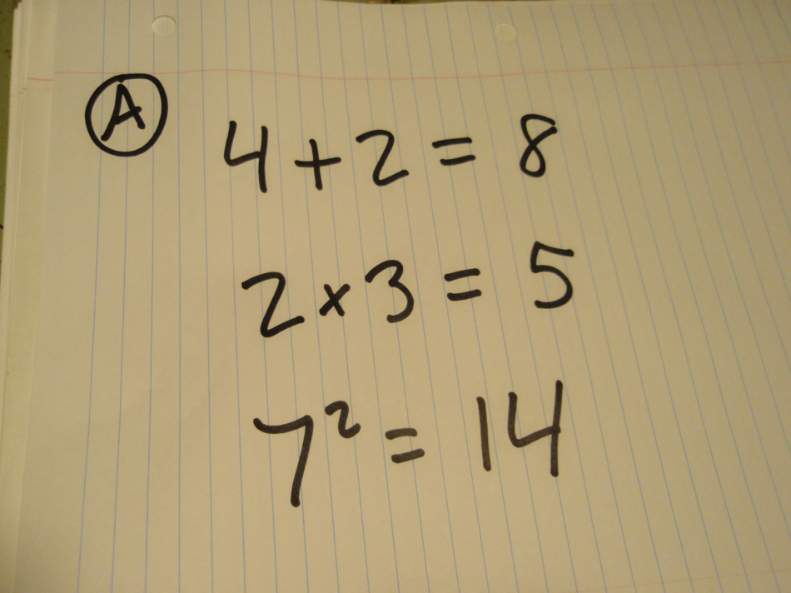
4. Encourage Your Child to be Independent in Maths
http://blogs.psychcentral.com/always-learning/files/2010/05/math-mistakes-May-5-2010-003.jpg
From Maths Lab 2007

Slide 10
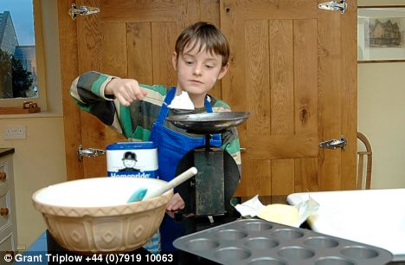
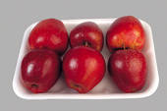
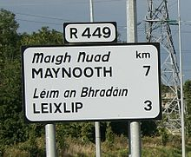
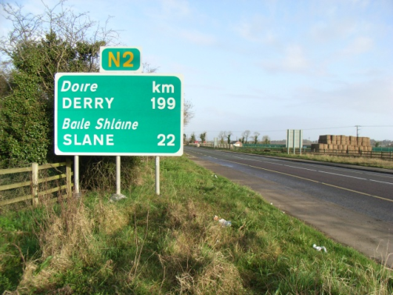
5. Use Maths with your Child in Daily Life

Slide 11
6. Display Maths Work at Home

Slide 12
7. Communicate with your Child’s Teacher
http://www.ncca.ie/uploadedfiles/G.5.%20Test%20results1.jpg

Slide 13
8. Be Realistic about Textbooks

Slide 14
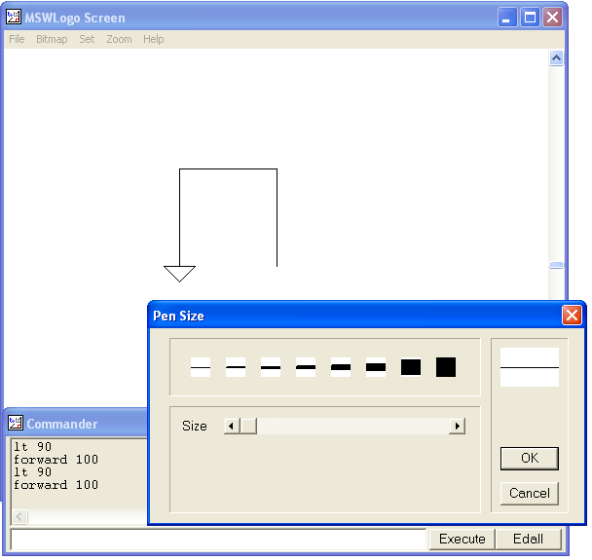
9. Challenge a High-Achieving Child
MSW Logo

Slide 15
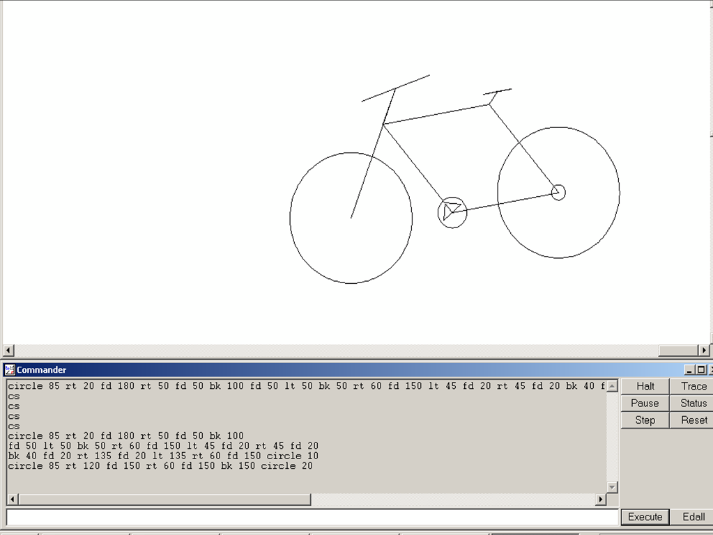

Slide 16
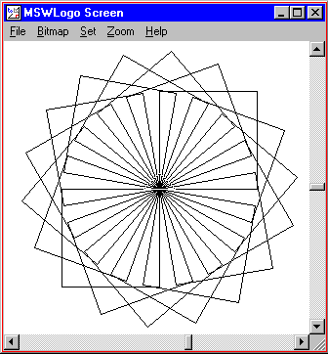

Slide 17
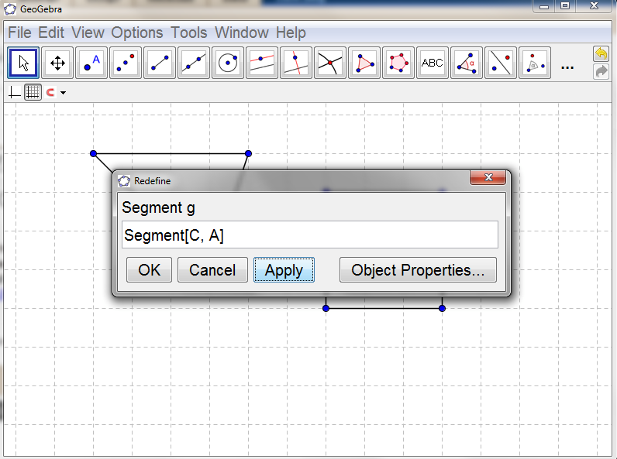

Slide 18
Websites
Logo: http://www.softronix.com/logo.html
Geogebra: http://www.geogebra.org/cms/
Geogebra (Primary School Version): http://www.geogebra.org/en/wiki/index.php/Release_Notes_GeoGebra_4.0#GeoGebraPrim

Slide 19
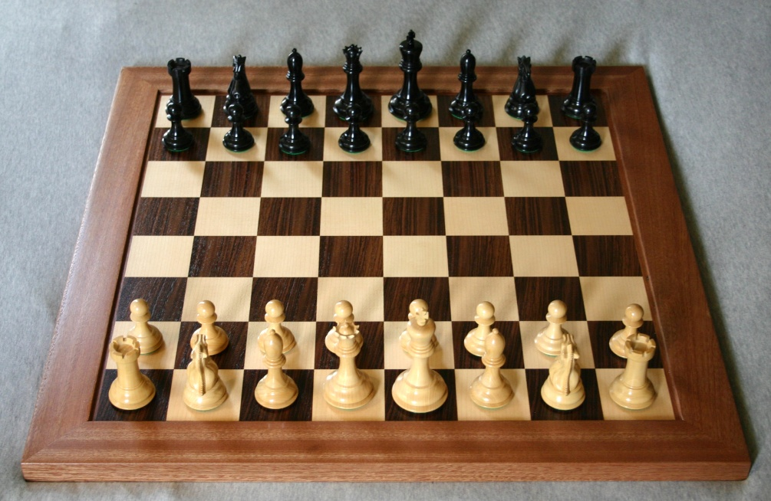
10. Play Games that Encourage Mathematical Thinking

Slide 20
Discussion

Slide 21
Notes to accompany this presentation are available at http://seandelaney.com/2011/11/15/how-parents-can-help-their-child-learn-maths/.

